Slide 1
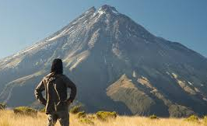
Homoeopathic oncology- Challenges, Experiences and Out comes
Dr Vinu Krishnan MD (HOM), PG (Dip) IACH, Greece,
PG( Dip) Anthroposophy, Switzerland
www.drvinukrishnan.com

Slide 2
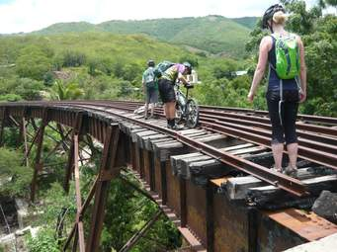
CHALLENGES..
1, Active lesions
2. Post treated lesions, Sx/CT/RT- Recurrence..?
3. Upsurge of Tumor markers.
4. Relapses in hematological malignancies.
5. Metastatic CA-
a) fluid over load
b) fever
c) flatulency
d) frequency of acute d’s and pain

Slide 3
Challenges– contd--
6. Immuno- compromised status
7.Residual effects of treatment.
8. Control of intervening infections.
9. Wide spread metastasis.

Slide 4
Surgical Challenges
1.Scar formation.
2.Fibrosis
3.Keloid formation
4.Loco regional recurrence.

Slide 5
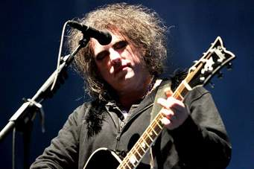
Chemo therapy can be curative in..
Acute Leukemia
Wilms tumor
Ewings sarcoma
chorio CA
Hodgkins disease
lymphosarcoma
burkitts lumphoma
Testicular tumors

Slide 6
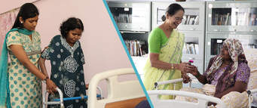
Chemotherapy can have only palliative effect in..
Breast CA
Ovarian CA
Endometrial CA
Prostatic CA
C/C Lymphatic leukemia
C/C Myeloid leukemia
Head and neck CA
Lung (small cell) CA

Slide 7
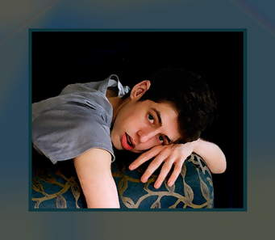
Chemotherapy is less sensitive in
Colo rectal CA
CA stomach
CA esophagus
Renal CA
Hepatoma
Bronchogenic(non small cell) CA
Malignant melanoma
Sarcoma

Slide 8
Pathogenesis of CA
Chemicals/ viruses/irradiation..
Acquired mutations inherited mutations
protooncogenes >oncogenes>expression of tumor suppressor genes (P53,Rb)
Uncontrolled cell proliferation/<apoptosis/
alterations in telomerase
Development of primary tumor

Slide 9
Adjuvant & neo adjuvant chemo therapy
Chemo given after surgery/ RT to destroy micro mets and prevent development of secondary tumor.
Chemo given before Sx/ RT in order to diminish the volume of large primary neoplasm.

Slide 10
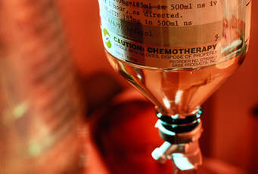
Chemo therapy challenges-
Pancytopenia
Apthae .
Discoloration of skin/nails/hair.
Alopecia.
Decompensated physiological status
a)< appetite
b)sleep<
c)Nausea n vomiting
d) hiccough

Slide 11
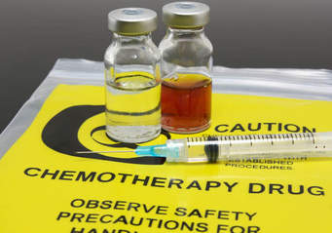
Chemo therapy challenges…contd..
6. Emotional struggles- anxiety/dementia/mood changes/
7. Failure of optimisation of fluids and electrolytes-
a) Hb,
b)Na
c)K
d) Calcium levels

Slide 12
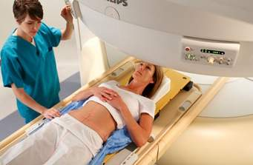
Radio therapy challenges-
Necrosis
Dermatitis n eczema.
Scars.
Atrophy of glands ( salivary/lachrymal/
bartholinis)
Discoloration of skin and nails.
Alopecia ( head/ beard)

Slide 13
EXPERIENCES..!
1.12 years of study both OPD N IPD .
2. Real n rational observations.
3. Logical derivations.
4. Fruitful conclusions.
5. Promising predictions.
6.Opening of a new Era.
7. Paradigm shift in oncological work ups.

Slide 14
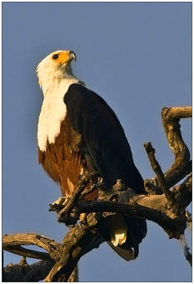
Observations
Fifty millesimal potencies in active lesions.
frequent repetition in active lesions.
constituitional medicine on post treated case to avoid recurrence and metastasis.

Slide 15
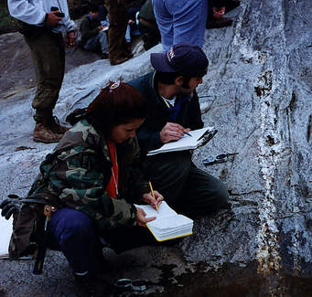
Observations
Pathological similimum along with main medicine in active lesions depending upon the site , nature and organ affected.
Physiological doses needed to revive the lost physiologoical homeostasis.

Slide 16
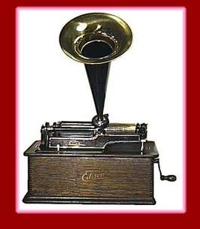
Derivations
Determine the aim in each and individual case.
Metastatic CA needs a combined approach of constituitional and pathologic prescription.
“Hooking method” is the choice for cases coming with residual effects after conventional procedures.

Slide 17
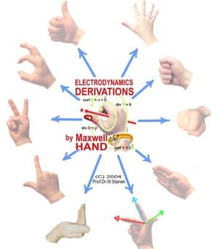
Derivations
Pace of the tumor growth along with chance of metastasis and recurrence an be avoided.
Intervening infections can be controlled.
metastatic foci can be reversed to some extent .

Slide 18
Conclusions
A lot to be explored with hpathic intervention in oncology.
As usual, deleterious effects of treatment procedures are less with Hpathy.
This can be used as along, adjuvant, neo adjuvant or alternative in some cases to an extent.

Slide 19
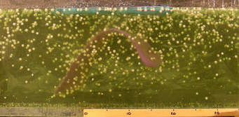
Conclusions
Reconstruction of physiological equillibrium is clear and transparent when compared to other procedures.
QOL is the main factor which is preserved all during the treatment.
Enhancement of survival rate is obvious.

Slide 20
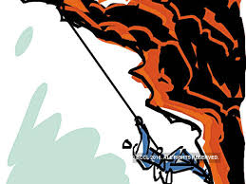
Therapeutic goals
Cyto- reduction of primary tumor.
Control of intervening infections.
Reversal of metastatic foci.
Lymph node regression
QOL
Survival rate
physiological equillibrium.
Fitness for other interventions.

Slide 21
Predictions
Trajectory of each case shall be predicted .
Essential and inevitable metastasis can be post pond with this prediction.
Therapeutic prognosis can be explained.
General well being of the patient can be enhanced .
Every time patient can be brought to a new state of improved health even though not cured.

Slide 22
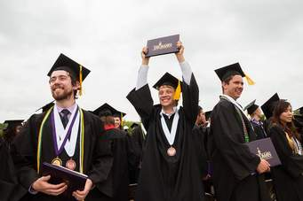
OUTCOMES..
1.Evolvement of scientific and transparent protocol and guidelines for Hpathic oncology for Targeted cases.
2. Complementary therapy(along)
3. Adjuvant therapy.(after)
4. Neo Adjuvant therapy(before)
5. Reconstructive therapy.
6. Preventive therapy
( secondary/ metastasis)

Slide 23
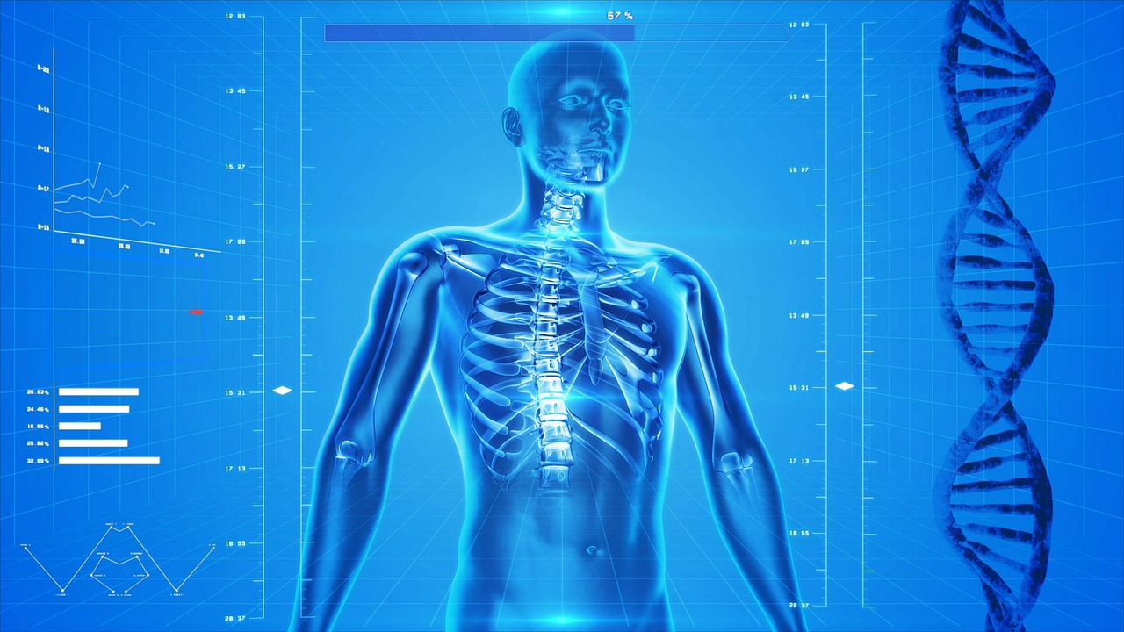
Thank you
THANK YOU
drvinukrishnanmd@gmail.com 9447101956

